Slide 1
Transmission Based Precautions
Behavior intervention services
2644 Metro blvd
Maryland heights, mo 63043
(314)395-9375
Duration: 30 minutes

Slide 2
what are pathogens?
Pathogens are microorganisms that cause diseases
Classified into 4 main categories
Viruses: colds, flu, Hepatitis B, AIDS, COVID-19
Bacteria: TB, Intestinal diseases
Fungi: Asthma/allergies, Athlete's foot
Parasites: Malaria

Slide 3
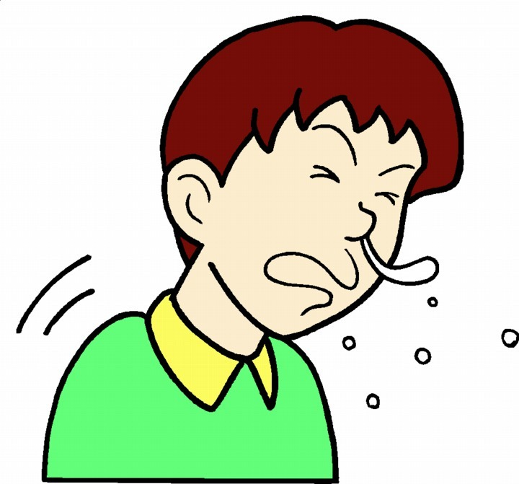
How Do pathogens spread?
Pathogens can spread through inhalation, ingestion, and contact
Inhalation: carried on respiratory droplets in the air and enters the respiratory system
Ingestion: ingested, usually through contaminated hand or food
Bloodborne contact: infected blood or bodily fluids gain entry through another person's blood, mucus membrane, or sexual contact

Slide 4
Chain of infection
Agent: begins with an infectious agent (bacteria, fungi, viruses, etc)
Reservoir: place where the agent lives, grows, multiplies (human, animal, environment)
Portal of Exit: path which the infectious agent leaves its host (nose, mouth, blood or bodily fluids)
Method of Transmission: the way the agent travels from reservoir to host (direct and indirect contact, airborne, droplet)
Portal of Entry: manner in which the agent enters the host (eyes, nose, mouth)
Susceptible Host: person who is unable to resist the invasion of the infectious agent

Slide 5
Standard and transmission-based precautions

Slide 6
Standard Precautions vs transmission-based precautions
Standard
Transmission-based
Based on the principal that ALL blood, body fluids, secretions, etc may contain transmissible infectious agents
Used for all individuals, visitors, and staff
Used when come into contact with blood, bodily fluids, non-intact skin, etc
Also used when coming into contact with equipment, linens, or surfaces that may be contaminated
Used when an individual has a known or suspected disease
Airborne precautions
Contact precautions
Droplet precautions

Slide 7
Standard precautions
Standard precautions should be used at all times while you are working. Do this by:
Performing hand hygiene
Using PPE
Handling care equipment, linens, etc. appropriately
Cleaning environmental surfaces
Practicing respiratory hygiene and cough etiquette

Slide 8
Airborne precautions
Implemented when an individual has or is suspected of having an illness that is spread through the air
These organisms can remain airborne for prolonged periods of time, over long distances, and are very contagious
For example:
Measles
Chicken pox
Shingles
Tuberculosis

Slide 9
Contact precautions
Used to prevent the transmission of illnesses easily spread through contact with the individual or contaminated items in their environment
Two types of contact:
Direct: skin to skin contact
Indirect: touching something in the environment that is contaminated
For example:
Scabies and lice
Herpes simplex virus
MRSA and VRE

Slide 10
Droplet Precautions
Used for illnesses that spread through large droplets from the respiratory tract that float in the air
Includes putting on a mask if you will be within 10 feet of sick individual
For example:
Influenza
Mumps
German measles
Whooping cough

Slide 11
Bloodborne pathogens (BBP)

Slide 12
Bloodborne Pathogens
Bloodborne pathogens are microorganisms that are present in blood or other potentially infectious material
Can enter your body through:
A break in the skin
Mucus membranes
Sexual contact

Slide 13
Bbp transmission
Most exposures do not result in infection
Risk of infection increases depending on:
Pathogen involved
Type/route of exposure
Amount of virus in the infected blood
Amount of infected blood involved
If post-exposure treatment was done
Immune status of infected individual

Slide 14
Main bloodborne diseases of concern
Hepatitis B
Hepatitis C
HIV

Slide 15
Hepatitis
Very infectious organisms that attack the liver
Hepatitis B
Can survive outside the body for up to 7 days on a surface such as a counter
No cure but a very effective vaccine
Hepatitis C
Most common chronic bloodborne disease
Symptoms include flu-like symptoms, fatigue, jaundice, loss of appetite

Slide 16
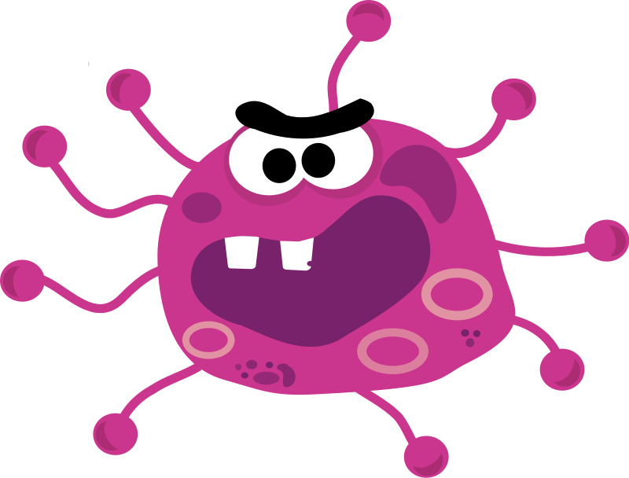
HIV
Attacks the human immune system
Does not survive outside the body for more than a few hours
No cure and no vaccine
Many people do not have symptoms for years or have mild flu-like symptoms
Spread from person to person through blood, sexual contact, or transfusions

Slide 17
How to keep yourself safe

Slide 18
Exposure Control Plans
Use to eliminate/minimize your risk of exposure
Contains the following things:
Exposure determination to identify employees that are at risk for exposure
Methods and controls used to protect you from exposure
Post exposure evaluation and follow-up procedures
Updated annually

Slide 19
Exposure Controls
How to reduce your risk:
Practice universal precautions
Use personal protective equipment
Use sharps disposal containers
Maintain a clean and sanitary workplace
Use biological hazardous waste containers

Slide 20
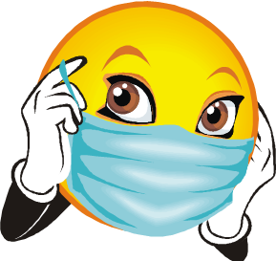
Types of PPE
Gloves
When you touch or have the potential to touch:
Bodily fluids
Non-intact skin
Potentially contaminated surfaces
Masks
Protect your face/mouth from pathogens transmitted through the air

Slide 21
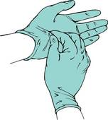
Applying and removing ppe
Put on mask
Put on gloves
Complete the task you needed the mask and gloves for
Take off gloves
Take off mask – remember not to touch the outside surface of your mask while removing it
Complete hand hygiene and wash your hands with soap and water for 20 seconds
You should also be wearing gloves during med passes and hygiene tasks

Slide 22
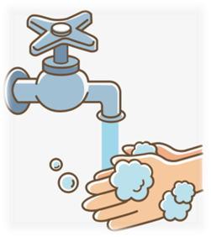
Hand Hygiene
Wash your hands with soap and water for at least 20 seconds
Times to practice hand hygiene:
When you arrive to work and leave your shift
Before and after direct contact with your client
After touching bodily fluids (yours or your client's)
Before preparing or eating food
After using or assisting your client with using the restroom

Slide 23
How to wash your hands
In order to be effective, you must follow the proper procedure:
Check that you have enough soap and paper towels
Turn on the faucet and make sure the water is warm – keep the water running so that you aren't re-contaminating your hands by turning the faucet on and off
Apply an appropriate amount of soap – apply to tops and bottoms of hands, fingers, and wrists
Clean between your fingers and under fingernails – wash your hands for 20 seconds
Rinse your hands well under running water with fingertips pointing down
Dry your hands thoroughly with a paper towel

Slide 24
hand sanitizer vs soap and water
Hand Sanitizer
Soap and Water
Routine decontamination of your hands
YOU SHOULD STILL WASH YOUR HANDS WITH SOAP AND WATER AS SOON AS POSSIBLE
Hands are visibly dirty or contaminated with blood or other potentially infectious materials

Slide 25
How to properly sanitize
Read the directions on your cleaning product
Pre-clean the surface if necessary
Make sure to wash the area with soap and water if called for in the directions or if surface is visibly dirty
Follow the contact time
Find this in your directions. Make sure your surface is wet the whole time
Wear gloves and wash your hands
Be sure to wash your hands after cleaning, even if you wore gloves to do so
Put your cleaning supplies back away out of reach
Source

Slide 26
Communicable Disease Precautions

Slide 27
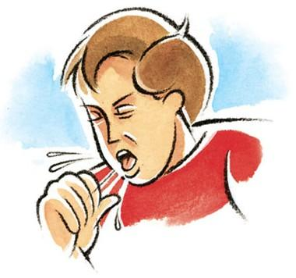
What is a Communicable disease?
A communicable disease is one that spreads from one person or animal to another or from a surface to a person. They are the result of pathogens, such as viruses and bacteria. Communicable diseases include colds, flu, Covid-19.
Symptoms vary, but most common ones include:
Fever
Cough
Shortness of breath
Chills
Unexplained stomach issues
Muscle Pain
Headaches
Sore Throat
New loss of taste or smell
Severe/unusual fatigue

Slide 28
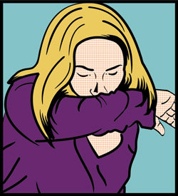
Hygiene Tips
Wash your hand frequently
Use soap and water and wash for at least 20 seconds
Cover your coughs/sneezes with your elbow
Avoid touching your mouth/nose/eyes with unwashed hands

Slide 29
It's good practice to...
Practice appropriate personal space when possible
Eliminate unnecessary touching (hugs/handshakes)
Practice with clients as much as possible
Wear a mask when feeling under the weather
Avoid close contact with people who are sick & wear proper PPE
If your client doesn't feel well monitor symptoms and encourage rest as much as possible
Contact site supervisor if symptoms worsen on your shift
Stay home when possible if you feel sick

Slide 30
Sick/ Illness Communication
Please notify your supervisor if:
you're feeling sick/ under weather if symptoms are preventing you from coming to work
You run a fever (temperature over 100.4), have a cough, or have difficulty breathing or have any other communicable disesase symptoms

Slide 31
Sick Procedures
If you're sick, you're required to wear a mask when coming to work
Continue to self-monitor and report any medical concerns to your site supervisor as soon as possible.
If working in any client’s parents’ or guardians’ home, these additional steps should be followed.
Notify your supervisor before arriving at the client’s home if ill or you have a fever (100.4).
Use hand sanitizer prior to entering the home
Wash your hands often, and for the recommended 20 seconds.
Employees who are sick are required to wear a 3-ply mask or an N95 while in close proximity to any client or coworker.
Anyone who wants to wear a mask/facial covering is welcome to do so.
Review and acknowledge specific department procedures and protocols for cleaning and sanitation.
Speak with HR or site supervisor if you have questions or concerns.

Slide 32
ISL Procedures
Continue to self-monitor and report any medical concerns to your site supervisor as soon as possible.
If temperature is over 100.4 contact your site supervisor immediately before coming to work. If you develop symptoms on shift, put on your mask, then contact your site supervisor.
All staff will also be required to wash their hands before and after shift. Regular hand washing should occur throughout shift
Employees who are sick are requried to wear a 3-ply mask or an N95 while in close proximity to any client or coworker. Anyone who wants to wear a mask/facial covering is welcome to do so.

Slide 33
GROW & Sprout Procedures
Continue to self-monitor and report any medical concerns (including communicable symptoms) to your site supervisor as soon as possible. If temperature is over 100.4 contact your site supervisor immediately
If you develop symptoms on shift, put on your mask, then contact your site supervisor.
All staff are required to wash their hands before and after shift. Regular hand washing should occur throughout shift.
Employees who are sick are required to wear a 3-ply mask or an N95 in close proximity to any client or coworker.
Anyone who wants to wear a mask/facial covering is welcome to do so.
If sick, clients are required to wear masks to their best ability

Slide 34
Parent/ Guardian Home Procedures
Staff are asked to take their temperature and self-assess for symptoms,1 hour before their shift starts and report to their supervisor if they have a fever (100.4or higher) or any other communicable symptoms.
Staff should sanitize or wash their hands upon entering and exiting the home.
Staff should work in one area of the house (if possible) that has been sanitized. Clean any area in the home before leaving shift.

Slide 35
Extra Cleaning
Disinfect/sanitize your area when you get to work and when you leave
Clean and disinfect frequently used objects and surfaces more often and throughout your shift:
Door handles
Light switches
Remotes
Faucets
Handrails
Phones
Keyboards

Slide 36
580 Pandemic Policy
BIS understands that communicable diseases can happen in the workplace. BIS decisions involving persons who have communicable diseases shall be based on current and well-informed medical judgments concerning the disease, the risks of transmitting the illness to others, the symptoms and special circumstances of each individual who has a communicable disease, and a careful weighing of the identified risks and the available alternative for responding to an employee with a communicable disease.
BIS understands that managers are not medical professionals and are not responsible for diagnosing diseases (or illnesses), providing medical advice, or giving recommendations of physicians. However, BIS does recognize that in the certain health crisis situations such as a global pandemic (as deemed by the CDC or local governing source) or health epidemic that certain health recommendations or guidelines will need to be implemented to ensure the safety of BIS employees, individuals served and supported, as well as, the general public.
In the event the Center for Disease Control (CDC) provides guidelines for implementing such procedures, BIS will follow said guidelines through amending policy and procedures, providing managers general recommendations for recognizing symptoms of the disease, and ensuring all employees are informed of any changes or recommendations as necessary.
These procedures can include but are not limited to monitoring body temperatures, recognizing symptoms of disease (as provided by CDC), asking employees specific questions regarding symptoms, asking about travel, and requiring physician release before returning to work as deemed necessary.
In the event of a national or worldwide pandemic BIS also will strive to keep the work place as safe as possible. This includes but is not limited to implementing stringent and frequent sanitization protocols for all work locations, limiting and/or restricting visitors in all locations (including residential and day programs), enforcing social distancing practices, and any other precautions as deemed necessary by the CDC or state/federal governing officials to ensure the health and safety of all individuals served.
During a pandemic if an employee reports to a manager that they are not feeling well or are sick, the manager will follow the guidelines below:
• Ask symptoms of illness (specific to pandemic) and how long they’ve been displayed
• Ask if employee has had any known exposure to pandemic disease or illness
• Recommend employee contact primary physician or health care provider
• Notify HR Director of employee symptoms immediately

Slide 37
582 Infection control & Prevention
All employees of BIS are required to follow the safety precautions outlined in the Blood borne Pathogen training received at the beginning and throughout your employment. The training program follows the standard operating procedures governing universal precautions.
Employees should know the location of all protective devices and check to see that the devices are in proper working order. If the devices are not present or not in working order, employees must immediately notify his/her supervisors.
Approved protective equipment shall be worn in specified work areas as outlined in Blood borne Pathogen training.
Gloves should be worn when it is reasonably anticipated that your hands will be in contact with mucous membranes, non-intact skin, moist body substances, surfaces/items that may have been soiled with these substances, and/or individuals with a rash. Gloves must be changed between clients and between contacts with different body sites of the same client. Hypoallergenic gloves are available for those who have allergic responses and who have a note from the doctor. Staff also are required to keep those gloves with them and must request a refill at least seven days in advance of running out.
All employees are required to sue proper hand-washing technique as outlined in Blood borne Pathogen training.
Soiled items are to be disposed of/cleaned as outlined in Blood borne Pathogen training.
To the extent permitted by law and in order to ensure the health and safety of all individuals supported, to the extent permitted by all, BIS requires that all employees report to the Administrative Director if they have any communicable diseases that could cause a danger. All information will be kept confidential.

