Slide 1
Event Management Report Form Training
Duration: 40 minutes
Notes:
The following training is to provide you with information essential to understand when to complete an Event Management Report Form and How to do it.

Slide 2
What is an EMT and why do we have to complete one?
EMT (Event Management Tracking Form).
The purpose of EMTs is to enable DMH/SB40 boards to track what happens to individuals.
BIS also uses EMTs as a means of gathering information about individual-related incidents and med errors.
Correct information on EMTs is essential for agency tracking purposes and quality enhancement.

Slide 3
So, an incident happened with a BIS client, now what?
First, we want to make sure the client is safe, and all necessary treatment has been provided.
Second, notify your supervisor by phone.
Lastly, an EMT must be completed and submitted by the end of your shift.
The management team will need to submit the EMT to DMH/SB40 Board within 24 hours.

Slide 4
Who is Responsible for completing the EMT?
The staff on shift is responsible for completing the EMT. If there was a discovery situation, the staff who discovered the event/injury will complete the EMT and submit it thru Setworks.
EMTs must be completed by the end of your shift through Setworks.
The staff that witnesses the incident does not have to be the staff to write the report, but it is preferred. Witness can fill out their own report with statement.
The witness can provide a detailed description of the events to the reporter to complete the EMT.
The site supervisor should be notified of the event and the manager will notify the guardian and Case Manager.

Slide 5
Reasons to Complete an EMT
From the following list of DMH definitions, choose only one incident type that best describes the event:
Fill out an Event Report Form for any of the following categories and contact the supervisor; supervisors contacts Guardian:
Reportable Category #1: All events where there is a report, allegation, or suspicion that an individual has been subjected to Misuse of Consumer Funds/Property, Neglect, Physical Abuse, Sexual Abuse, or Verbal Abuse.
Reportable Category #2: All…
Emergency Room Visits
Non-scheduled Hospitalizations
Deaths of Individuals Served by DMH
Medication Errors that Reach an Individual (NOT documentation errors)
Incidents of Falls
Uses of Emergency Procedures
Chemical Restraint
Manual Restraint
Mechanical Restraint
Time Out Procedures
Reportable Category #3: All events where there is Law Enforcement or emergency personnel involvement when the DMH consumer is either the victim or alleged perpetrator, or Law Enforcement is support in the event.
Reportable Category #4: All events that result in disruption of DMH service due to fire, theft, or natural disaster resulting in extensive property damage or loss.
Reportable Category #5: All events where there is sexual conduct involving an individual, and it is alleged, suspected or reported that one of the parties is not a consenting participant.
Notes:
From the following list of DMH definitions, choose only one incident type that best describes the event:
Choking (requiring intervention): When food or an object has obstructed the airway and the Heimlich maneuver or other medical intervention is required to save the life of an individual.
Violation of Consumer rights: Any suspected violation of consumer rights as established by RSMO 630.110 or where there is a suspicion or allegation of abuse or neglect.
Consumer struck object resulting in injury: Any physical force inflicted upon an object by a consumer.
Elopement: When a consumer’s absence raises reasonable concern for the safety of consumer or others, or concern the consumer will not return. (Record return date and time.)
Found on floor/ground (not witnessed): Found consumer on the floor from an apparent loss of an upright or erect position of the body.
Fall to floor/ground (witnessed): Sudden loss of an upright erect position of the body. The fall did not result from any forcible physical actions of another person.
Near fall (lowered to floor by staff): Sudden loss of an upright or erect position of the body. Intervention to assist and lower the consumer to the floor was provided.
Fire: Starting a fire whether intentional or due to impaired cognition or judgment.
Inappropriate language by staff toward consumer: Staff using profanity or speaking in a demeaning, non-therapeutic, undignified, threatening or derogatory manner in a consumer’s presence.
Ingestion of non-food item: Ingestion of an item that is not food, water, medication or other commonly ingestible item that may constitute a hazard to health.
Medical emergency-consumer: A medical emergency occurs while a consumer is receiving active services in a facility, program or in the community with staff. The consumer is sent to a hospital or emergency care clinic in an urgent situation and receives medical treatment. This is used only when another incident type does not first describe the incident.
Misuse of consumer funds/property: Staff is suspected to have misappropriated or converted a consumer’s funds or property for their own benefit.
Physical altercation between consumers: Any physical force inflicted upon a consumer by a consumer.
Physical altercation consumer & non staff: Any physical force inflicted upon the other when an altercation occurs between consumer and non-staff.
Physical altercation – staff & consumer: Any physical force inflicted upon the other when an altercation occurs between a staff and consumer.

Slide 6
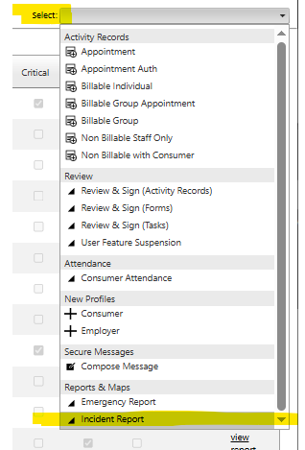
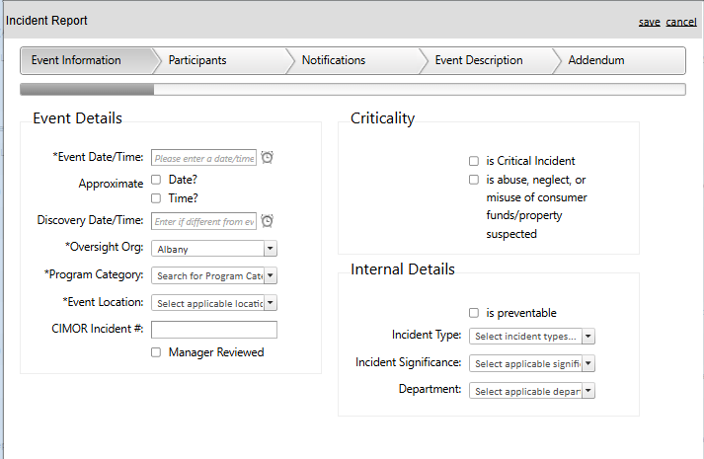
Reportable Category #6: All events where there is any threat or action, verbal or non-verbal, which conveys a significant risk of immediate harm or injury and results in reasonable concern that such harm will be inflicted.
Reportable Category #7: All events where the consumer ingests a non-food item (any item that is not food, water, medication, or other commonly ingestible items).
Reportable Category #8: All events that result in a need for an individual to receive life-saving intervention or medical/psychiatric emergency intervention.
DMH Event Report Form should still be filled out for the following:
Behavior of an unusual nature for the individual
Individual escalations that result in injury of staff or individual
Property Damage that results in an item needing replacement (including staff, consumer, and community property)
Elopement
Vehicle collisions or accidents where an individual is present in an involved vehicle
Falls or drops by the individual
Individual altercation
Any other situations that staff deems necessary to report
Notes:
Possession of weapon: Having on one’s person or in one’s room an instrument or an object manufactured or altered to have potential to cause injury to oneself or to another individual. This includes a lighter or matches where/when not allowed.
Property loss/destruction: Significant or notable destruction of property.
Sexual conduct - consumer/non-consensual: Any sexual act involving a consumer when it is suspected or alleged that one of the parties was not a willing participant. This includes those incapable of giving consent due to guardianship or other reasons.
Sexual conduct – staff & consumer: Any suspected or alleged sexual conduct between staff and consumer including but not limited to the definition of sexual abuse.
Suicide attempt: Any action(s) taken by an individual with the intent to kill oneself but he/she is not successful.
Theft by consumer: The act or an instance of stealing committed by a consumer
Vehicular accident: Consumer was involved in the collision of a vehicle with another object.
Consumer self-harm: Any physical force inflicted by a consumer on self.
Graphic threat of harm: Any threat, verbal or non-verbal, which conveys a significant risk of imminent harm or injury and results in reasonable concern that such harm will actually be inflicted.
Seizures: A convulsion or attack of epilepsy.

Slide 7
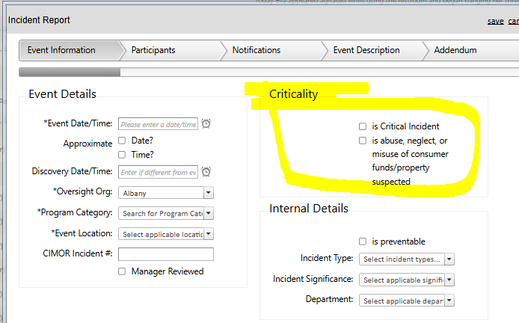
If the event is considered a DMH Critical Incident, you'll mark critical on Setworks. Critical Incidents are defined as follows:
Death of an individual suspected to be other than natural causes.
Injury to an individual.
Any incident of abuse/neglect, including abuse/neglect involving death, serious injury, and sexual abuse.
Selling food stamps; individual offering to buy staff anything (gifts, food, household items, etc.)
Suicide attempt resulting in an injury requiring medical intervention
Elopement with law enforcement contacted or involved
Criminal activity reported to law enforcement involving an individual as a perpetrator or victim when the activity occurs at a facility. If not at a facility, then the criminal activity is serious (felony, etc.)
Fire, theft, or natural disaster resulting in extensive property damage, loss or disruption of service in department state operated facilities.

Slide 8
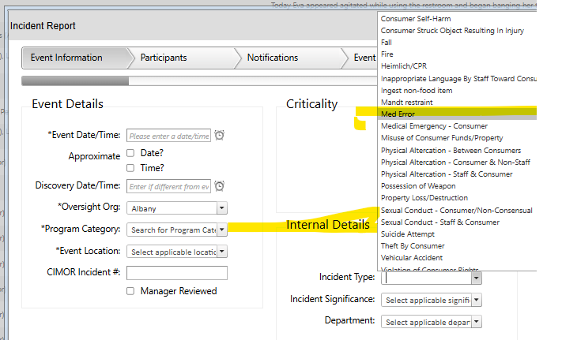
What about Medication Errors?
Notes Regarding Medication Errors:
Medication errors are completed on paper forms or in Setworks in each location.
If the medication error occurs when the individual is not in care, it is not an error that we report.
Managers/Directors will be responsible for determining the severity of the Med error.
Most med errors will be determined ‘Minimal’ unless medical treatment and/or intervention is required
Contacting the doctor regarding the med error is not considered medical treatment and/or intervention unless the physician gives an order to counteract the med error (i.e., ER visit, change in dosage schedule, etc.)
Missing a dosage
Giving an individual the wrong meds
Giving too much medication
Giving discontinued medication

Slide 9
The Physician’s Written Order should be written exactly how it is on the MAR
Be sure to follow the chain of command within the home.
If this is an abuse/neglect incident, the Manager will notify the ISL Director immediately by phone.
Quantity is the amount of med given. Variance is how many times the error occurred.
A follow up email must be sent out to both Site Supervisors, Community RN, ISL Manager, Director, and Executive Director providing summary of error.
The guardian and Support Coordinator should be notified separately by the ISL Manager or Department Director.

Slide 10
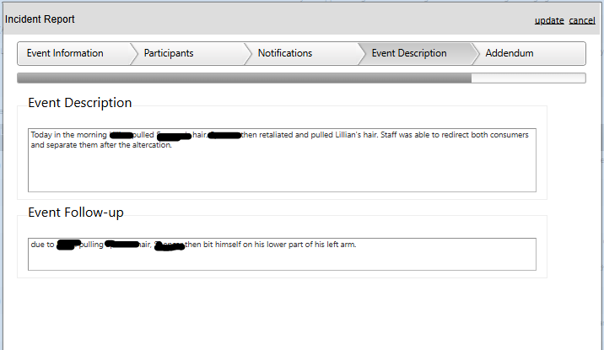
The narrative in the next section is the most important piece of the EMT.
Select the words carefully; write in clear, concise, professional terms, and pay attention to the spelling and grammar. Do not use abbreviations or symbols.
Document only the basic situation and keep the description to a minimum. When in doubt, ask someone else to read the narrative before finalizing the EMT description.

Slide 11
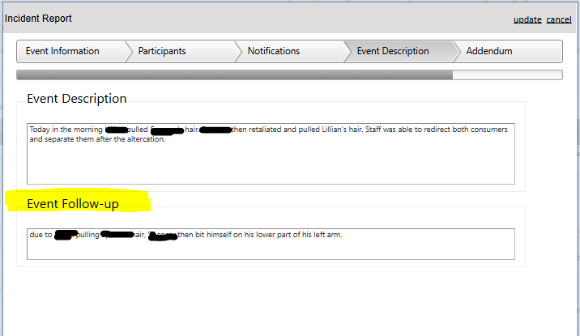
Follow Up Action
Follow Up/Medical Action should be whatever was done by the agency or supervisor in response to the incident.
Staff will monitor…
Team will review…
Supervisor will re-train, re-education, review, schedule ,etc.
If a physician or Behavior Therapist needs to be informed that can also be included in the follow up action.
If it is a case of Abuse & Neglect the ISL Director will complete the follow up action.
Do not write anything that cannot be guaranteed to happen. For example, some things not to put on an EMT include:
Specific Employee disciplinary actions (these may change based on additional information gathered after the CERF is completed, etc.)
The phrase ‘BIS will conduct an investigation…’. It is possible that BIS will not, but DMH will expect one—and a report to go with it—if written.

Slide 12
Tips for Writing an EMT:
If Documenting an Injury:
Be sure to include how the injury occurred, if known, any first aid that was provided including pain medications that may have been administered and directions from nursing and/or supervisors.
If incident includes staff injury, ISL Manager & ISL Director must be notified by phone. HR Director must be notified of incident via phone or email.
If staff injury, must complete Workman’s Comp. Packet OR complete Refusal of Medical Treatment Form.
If Documenting a Medication Error:
Be sure to include information about the medication, time it was missed and dosage amount in the appropriate place.
If Documenting a Behavior:
Be sure to use the ABC format when describing behaviors.
Antecedent - what occurred directly before the behavior.
Behavior –do not document emotions, write down concrete observable actions.
Consequence – what happened directly after the behavior occurred.

Slide 13
Helpful Hints with Words for Writing Incidents Reports
WORDS TO NOT USE/THINGS NOT TO DO | WORDS TO USE/SUGGESTIONS
Staff told | Staff prompted
Staff sent client to room | Staff redirected client to have some down time or time to themselves
Staff took something away from client, either object or activity | Staff should NOT take things away from clients unless they are harming themselves or others
RESTRAINED | Staff prompted with physical guidance or used MANDT techniques to ensure safety
Grabbed | Placed/slid/touched
DO NOT TURN YOUR BACK TO SOMEONE WHO IS ANGRY | Always be prepared and aware of your surroundings
When clients are not getting along | Separate them
Do not write incident reports if you are angry or upset. Calm down take your time and give full detail without being negative about the client. Choose your words wisely.
List all attempts of redirection-verbal prompts, attempted to channel into activity, redirected to go for a walk, engaged inside dialogue, etc.
Write an accurate report with dignity and respect
Use this process to ask “What can be done differently next time…”
Remember to remain objective. Do not use words such as “it was great day”, they were having “bad” behaviors. Write what happened.

Slide 14
EMT Procedures (Admin.)
Incident/Event Report Forms Procedure:
When an incident report must be filled out, the site Manager needs to notify the Department Director according to the communication policy. The staff are to fill out an incident report in Setworks.
The Setworks system generates an alert email every night at 5am to the Department Directors, Executive Directors, RN and BCBAs that an incident report was done. Each person is responsible for reading the report and follow up as necessary based on their position.
Staff go into Setworks select the menu top right and scroll down for incident report. Next go to the bottom left and click add new. Staff are to complete all sections of the form.

Slide 15
Here is a list of incidents that require an Event Report Form to be filled out.
Ingestion of a non-edible food item
Destruction of staff property
Elopement
ER Trip
Fall
Fire
Consumer Found on Floor
Misuse of Funds
Injury to Consumer- Unknown or known Origin
Med Error
Near Fall
Physical Abuse
Neglect
MANDT Restraint
Sexual Abuse
Theft
Threat/Harm
Vehicular Accident
Extensive Property Damage- any item that must be replaced
The site Manager must contact the guardian of the individual within 24 hours and document this contact on the Event Report Form as indicated. Guardians should be notified within 2 hours of the incident.

Slide 16
If any of the incidents have occurred below the Department Director, guardian and SLRO must be notified immediately by phone call.
Emergency Room Trip
Vehicular Accident
Sexual abuse
Fire
Abuse and neglect
If the incident is a critical incident the Department Director will immediately contact SLRO. If after hours or weekends the emergency phone number will need to be called. The Department Director will also make immediate notification to the Executive Director.
If staff fails to complete or notify the site Manager about a reportable incident progressive disciplinary action will occur up to and including termination.
If the incident is suspect abuse/neglect/misuse of funds the abuse/neglect policy and procedure should be followed as well.

Slide 17
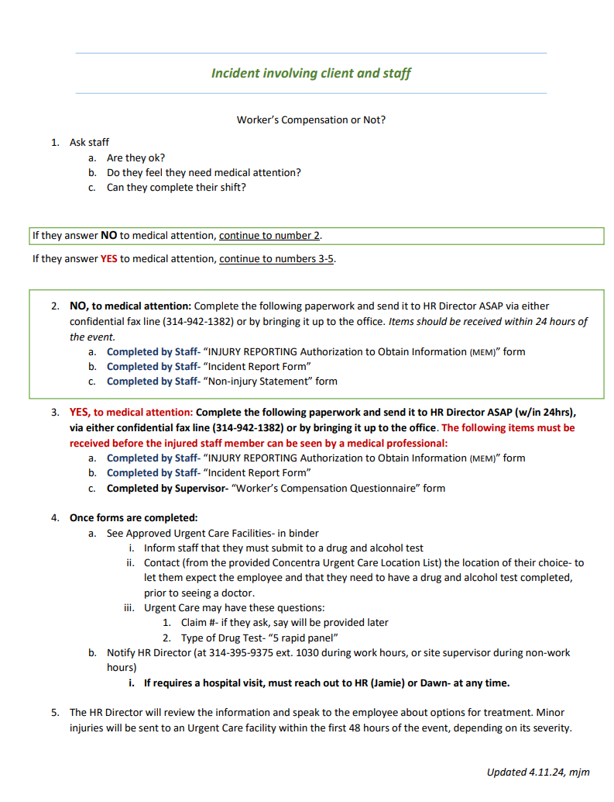
Sprouts

Slide 18
Grow- Day Program
Incident/Event Report Procedure:
Any time a reportable event occurs, Day Program Staff or Managers will alert the Director.
The staff are to fill out an incident report in Setworks.
The Setworks system generates an alert email every night at 5am to the Directors, Executive Directors, RN and BCBAs that an incident report was completed. Each person is responsible for reading the report and following up as necessary based on their position.
Staff go into Setworks select the menu top right and scroll down for ‘Incident Report’. Next go to the bottom left and click ‘Add New’. Staff are to complete all sections of the form.
Here is a list of incidents that require an Event Report Form to be filled out.
Ingestion of a non-edible food item
Destruction of staff property
Elopement
ER Trip
Fall
Fire
Consumer Found on Floor
Misuse of Funds
Injury to Consumer- Unknown or known Origin
Med Error
Near Fall
Physical Abuse
Neglect
MANDT Restraint
Sexual Abuse
Theft
Threat/Harm
Vehicular Accident
Extensive Property Damage- any item that must be replaced

Slide 19
The Manager or Director must contact the guardian of the individual. Guardians should be notified within 2 hours of the incident.
If any of the below incidents have occurred the Director, guardian and SLRO must be notified immediately by phone call.
Emergency Room Trip
Vehicular Accident
Sexual abuse
Fire
Abuse and neglect
If the incident is a critical incident the Director will immediately contact SLRO. If after hours or weekends the emergency phone number will need to be called. The Director will also make immediate notification to the Executive Director.
If staff fails to complete the EMT or notify the Manager about a reportable incident progressive disciplinary action will occur up to and including termination.
If the incident is suspect abuse/neglect/misuse of funds the abuse/neglect policy and procedure should be followed as well.

Slide 20
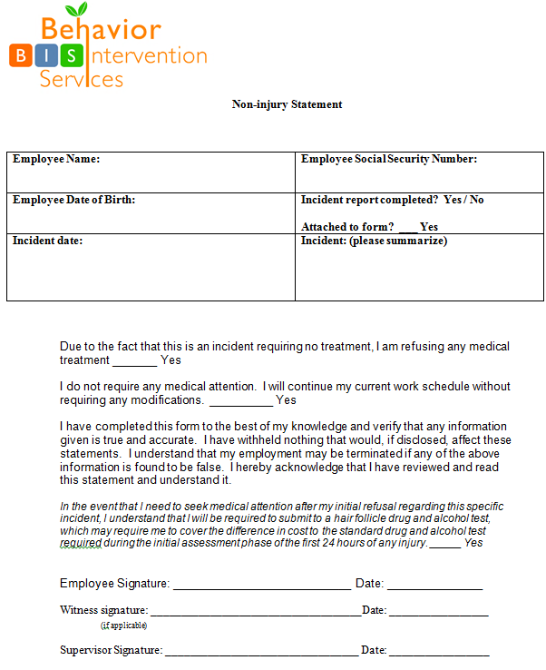
The EMT is complete, now what?
If it is a Med Error or injury to the client, the Community RN should also be included on this email.
If a staff injury is involved (i.e., Workman’s Comp) then the HR Director should also be copied on the email. If staff refuse medical treatment complete Refusal of Treatment Form.

Slide 21
Quick Guide to Work Injuries
Injured staff – requesting medical attention | Injured staff – declining medical attention
Ask staff if they are ok or in need of medical attention. If yes, continue to next step | Ask staff if they are ok or in need of medical attention. If no, continue to next step.
MEM auth form (signed or electronic)
2) Incident report form or (insurance based clients) EMT form (DMH clients) | 2) Incident report form or (insurance based clients) EMT form (DMH clients)
WC injury questionnaire: completed by Site Supervisor; if site supervisor not available injured employee can complete it. Written statement must be provided by injured employee | 3)WC medical treatment refusal form
7) Send employee to approved Urgent Care facilities | 4)Turn in all completed items to Jamie, HR Director 24-hours of incident
Inform staff that they must submit to a drug and alcohol test
Contact the Concentra Urgent care of their choice to let them know to expect the employee and that they need to have a drug and alcohol test completed prior to seeing a doctor
Turn in all completed items to HR Director 24-hours of incident

Slide 22
How Many Forms?
General Rule: One incident, One EMT
However, if more than one person was injured or directly involved in the incident or multiple guardians need to be contacted, then an EMT must be completed for each individual (i.e. a vehicle accident where 3 people were injured, there will be a report completed for each person, if 2 people elope together, both guardians contacted, therefore 2 reports, etc.).
Notes:
The “General Rule” is One incident, One CERF
However, there are occasions when more then one CERF is required. Such as, If more than one person was injured or multiple guardians will need to be contacted, then complete a CERF on each individual.
For example: A vehicle accident where 3 people were injured, there will be a report on each person. Or, if 2 people eloped together, both guardians will need to be contacted, therefore 2 reports would be written.

Slide 23
Some Final Thoughts
The witness to the event must initiate the EMT process prior to the end of the scheduled shift. This may be completed by writing a statement, reporting the details of the event via telephone to the ISL Manager or ISL Director, etc.
Proper EMT documentation is an important part of everyone’s job.
Accuracy is essential.
All reporting of the event must be detailed.
The proper chain of command must be notified when an EMT is completed.
Notes:
Proper CERF documentation is an important part of your job.
Accuracy is very important, Make sure to check the form before you turn it in, by doing this you can catch errors and speed along the process.
You must be detailed in your reporting: Write objectively and use behavioral writing to define the event.
You Must Route “CERF” Report according to the protocol

Slide 24
Questions? Examples.

