Slide 1

Fundamentals of the Field

Slide 2
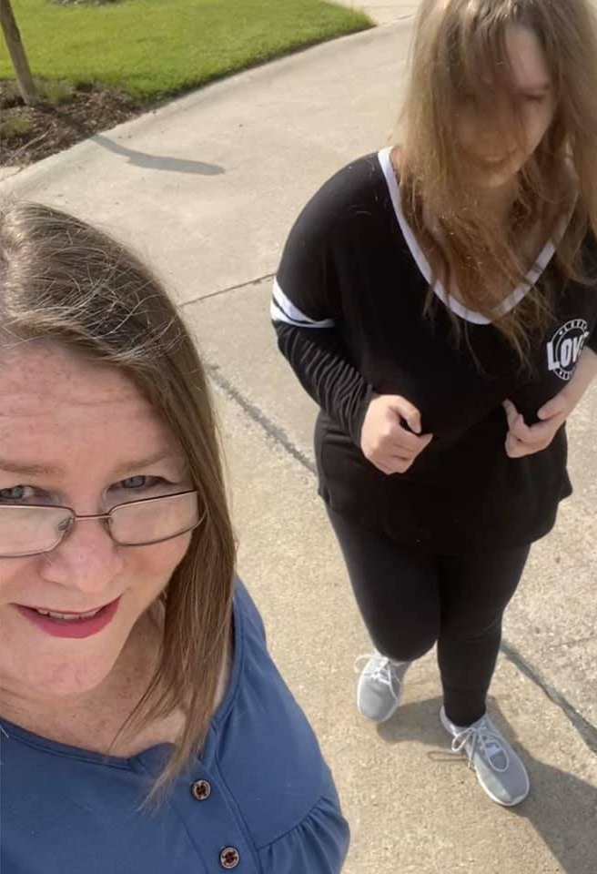
Staff in the Field
Expectations:
  Relationship with the family
  Respect
  Awake & Alert
  Electronics- Work Only
  Drug & Alcohol Use
  Arm's Length & Line of Sight
  1:1 (1:4) Attention
Notes:
Relationship with the family:
Your relationship with your client’s family should be courteous and respectful. We talked about this a little bit during ABA.
Avoid talking about your personal drama or if there are any concerns regarding BIS
If your client’s family comes to you with a concern regarding BIS, pass it along to your supervisor or let them know they should bring the concern up with your supervisor themselves if they prefer
If your client’s family asks you to do something that you do not think is in line with BIS policy or your client’s plan, tell the family that you will need to check with your supervisor before you can do whatever it is that they ask.
Respect
Show respect in everything that you do.
Respect your clients, their wishes, their lives, and their families
Respect your co-workers, supervisors, the work that you are all doing
Awake & Alert
Make sure you are always awake and alert while you are on your shift. Not only is it a BIS policy that you need to be awake during your shift but it will also make your life a lot easier.
If your client thinks that you are asleep or almost asleep, they may take advantage. You may catch them trying to do something they’re not supposed to (for example: a client that is on a limited calorie diet. If they think that you are not paying attention, they may try to get an extra snack or have more calories once they have used up all of their calories for the day)
All shifts are considered ‘awake’ shifts – if you are caught sleeping on shift by another staff or a consumer, you are subject to disciplinary action up to and including termination.
If you are awake and engaging with your clients, your shift will go a lot faster and easier. Your client will be in a better mood and (for me anyway) time seems to go much faster if you are busy or engaging with your client
Electronics
Items such as cell phones, tablets, laptops are restricted during work hours unless for work purposes. If you are caught by a supervisor playing on your phone when you should be engaging with a client, you may receive feedback.
If you have your electronics out while on shift, you also run the risk of them getting broken. If your electronic device gets broken while on shift by a client, the client’s payee (generally DMH) would be the one reimbursing you. This means that it will take a while and that there will be a lot of paperwork involved.
Just leave your phone put away as much as possible if you are on shift. It will make your life a lot easier.
Drug and Alcohol Use
BIS is a drug free zone. Any employee that seems to be impaired by or under the influence of drugs or alcohol will be required to submit to a drug and alcohol test. If the test comes back positive, the employee will be presented with some options in order to retain their position.
Kind of going along with this is BIS’ smoking policy. Do not smoke while on shift. This includes while at a client’s house, in the car with a client, or at day program.
Arms length and line of sight
All clients should be within arms’ length while in the community unless it states differently in their ISP. What does being within arms’ length of your client mean?
All clients are line of sight within their homes, again, unless stated in their ISP. Many clients can be out of line of sight while in their bedrooms or other designated areas of their homes for a certain amount of time. Please double check your client’s ISP or check with your supervisor if you are unsure how long your client can be out of your sight at home.
1:1 or 1:4 attention
While working within our ISLs, many of our clients receive 1:1 staffing. This means that there is one staff for every client. All houses share staffing overnight and generally later in the night or early in the morning. Some of our clients may share staffing at other times during the day, depending on the client
At day program, many of the clients are 1:3 or 1:4 (so 1 staff for every 3-4 clients). During an escalation or possibly at other times of the day, a client may receive 1:1 staffing, however the normal ratio is 1:4.

Slide 3
Ensuring Hygiene & Cleanliness
Hygiene tips:
Wash your hands frequently
  Use soap and wash for at least 20 seconds
Cover your cough/sneeze with your elbow
Avoid touching your mouth, nose, eyes with unwashed hands
Practice social distancing when possible
Stay home if you feel sick and contact your site supervisor
While working in the field, you should be keeping where you work clean. Do this by:
Sanitizing your work area when you come in and when you leave
If you have any work areas that are touched often (doorknobs, light switches, keyboards, remotes, faucets), sanitize those throughout your shift as well
Notes:
During this pandemic, it is important to practice good hygiene. To do this:
Wash your hands frequently; using soap and water and washing for at least 20 seconds
Be sure you are covering your coughs and sneezes with your elbow
Avoid touching your mouth, eyes, and nose with unwashed hands.
Practice social distancing as much as you possibly can – even when you are on shift.
If you feel sick, please stay home and contact your supervisor.
While you are working, be sure to keep your work area clean
Sanitize when you come in to your shift and when you are leaving
If there are any areas that you use more often – doorknobs, remotes, laptops, faucets, light switches – sanitize those more often throughout your shift

Slide 4
• Good hand hygiene and frequent hand washing
• Watch CDC's video demonstrating good hand hygiene. Good Hand Washing Video
• Proper cough and sneeze etiquette (cover your cough/sneeze with your elbow, use tissues, wash hands)
• Avoid touching your eyes, nose, or mouth with unwashed hands
• Social distancing (stay six feet away from people when feasible): eliminate unnecessary touching such as hugs and handshakes - This is hard for some of our clients; try and explain and teach them why this is important right now.
• Avoid close contact with people who are sick
• Avoid large crowds and gatherings – This can difficult for our clients and finding things to do with them in the ISLs. Let us know if you need some activities or ideas of things to do.
• Stay home if you feel sick and alert your manager
• If clients don't feel well encourage them to stay in their rooms
• Clean and disinfect objects and surfaces more frequently: door handles, light switches, remotes, faucets, handrails, phones, keyboards etc.
We ask that all employees inform the HR Director if any of the following occur before you report to work.
  If you come in close contact with anyone who has been directly exposed to or diagnosed with COVID-19 and you're showing symptoms.
  You've been tested for COVID-19 within the last 72 hours or for another job.
  If you run a fever (over 99.9), cough, or have difficulty breathing or any other COVID-19 symptoms.
  If you have symptoms of acute respiratory illness, you should immediately seek medical attention and follow the guidance of your health care provider. If you are diagnosed with or aware you’ve been directly exposed to COVID-19, please notify HR.
FOLLOW THESE GUIDELINES TO ENSURE SAFETY AND HYGIENE:
Notes:
Make sure that you are practicing good hand hygiene – washing your hands frequently
Practice proper cough and sneeze etiquette by covering your coughs/sneezes with your elbow
Avoid touching your eyes, nose, mouth, etc with unwashed hands
Practice social distancing when possible - also make sure that you are explaining to your clients why this is necessary
Avoid close contact with people who are sick
Avoid large crowds and gatherings - if you need ideas of what to do with your clients for outings or activities just contact your manager/director and they will give you some ideas
If you are feeling sick in any way stay home and immediately alert your supervisor
If your client feel well, encourage them to stay in their rooms
Some clients will not be willing to do this and we cannot force them to but try to explain to them why it is necessary
Clean and disinfect objects that are used more frequently like laptops, remotes, doorknobs, light switches
You should be notifying HR if any of the following things are happening:
If a close family member that you've been in close contact with has traveled to a high-risk area
If you come in close contact with anyone who has been directly exposed to or diagnosed with COVID-19 – this includes if you have another job and have been exposed there
If you plan to travel to an infected area
If you have a fever or any symptoms of COVID-19

Slide 5

Department procedures
ISL
Grow@BIS
Natural Home
All staff will have their temperature taken and answer a COVID-19 survey before shift
If temperature is over 99.9 or "YES" to any symptom questions, contact your site supervisor immediately
All staff will also be required to wash their hands before and after shift
All clients will have their temperatures taken daily
Employees are required to wear face mask or facial coverings during shifts when physical distancing cannot be enforced and during food preparation.
All staff will have their temperature taken and answer a COVID-19 survey before entering the DH building
If temperature is over 99.9 or "YES" to any symptom questions, contact your site supervisor immediately
DH staff and clients will be the only ones allowed in the building
DH staff will clean 3 times per day
Employees are required to wear face mask or facial coverings during shifts when physical distancing cannot be enforced and during food preparation.
Staff are asked to take their temperature 1 hour before their shift starts and report to their supervisor if they have a fever (99.9 or higher)
Staff are also being asked to work in one area of the house that has been sanitized
Employees are required to wear face mask or facial coverings during shifts when physical distancing cannot be enforced.
Notes:
Here are the COVID-19 department procedures:
ISL:
All staff will have their temperature taken and answer the COVID-19 survey just like when you have been at the office this week. If your shift starts at BIS's day program, day program will complete the survey and temperature check for you.
The staff that you are relieving should be the one completing the survey for you – if you have a fever or answer yes to any of the questions, you won't be able to work and they will have to stay until a supervisor or someone else can come in
You should be washing your hands at the start and end of your shift.
All clients should be having their temperatures taken every day – generally with the first med pass of the day
You should be wearing a mask when you cannot practice social distancing with your clients – med passes, assisting with hygiene routines, when you're preparing food for your clients
Grow@BIS:
Same as ISL – you will have your temperature taken and answer the COVID-19 survey at the start of the day
DH staff and clients are the only ones allowed in the building – if you are dropping your client off at the start of the day, a DH staff will come out to get them; if you are picking your client up at the end of program, a DH staff will bring them out to your car
DH staff should be cleaning the building 3 times a day
DH staff should also be wearing their masks/face shield when they cannot practice social distancing with their clients
Natural Home:
You should be taking your temperature an hour before your shift and reporting to the NHSM if you have a fever over 99.9
You should only be working in one part of the house that has been sanitized and also sanitizing before you leave your shift
If you cannot practice social distancing with your client, you should be wearing a mask or face shield

Slide 6
Training Checklists
Sent with your shadow email
In-Home Training Checklist
Shadow Evaluation
Day Program Training Sign Off
Must be completed before working with clients 1:1
Notes:
There are 3 different training checklists that will be filled out by various people while you are shadowing
Whichever checklist you need to fill out will be sent out to you in the email you get from Lauren with your shadow information in it
It is your responsibility to fill out the in-home training checklist any time you shadow in an ISL.
I suggest filling this out within the first 30-45 minutes of your shadow shift so that you do not forget.
You will work your way down the checklist and ask the staff you are shadowing with each question
Click link for in-home checklist and go through it
The Day Program Training Sign off is for staff that will be working at day program.
This will also be sent to you with your shadow confirmation email
Click link for day program sign off and go through it
The Shadow Evaluation is filled out by the staff that you are training with about you.
While this is for the other staff to fill out, it is also sent to you so that you can remind them to fill it out for you.
Click shadow eval link and go through it
These checklists must be filled out before you can be full duty released and begin working with clients independently.
If you do not fill them out while you are completing your shadow, you will get almost daily emails from Lauren reminding you to fill it out so that you can start working

Slide 7
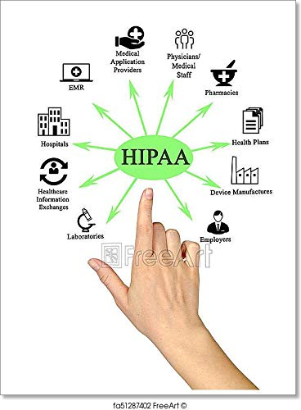
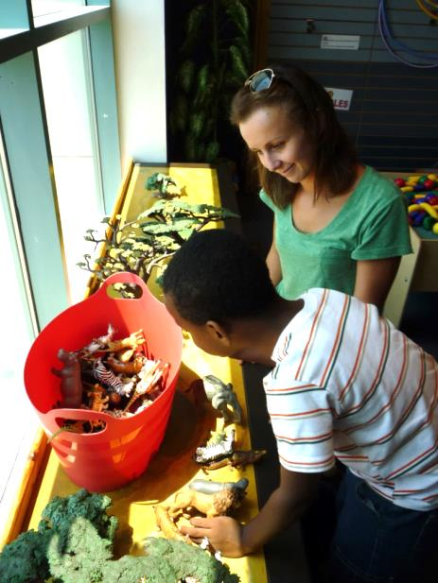
Client Interactions
Do not say “NO!” – use positive talk
Eliminating the words “must” “have” “don’t” “can’t” “stop” from your vocabulary
Power Struggles
Client Rights
Client Limitations
HIPAA
Role of Parents/Guardians
  Ex. Bedtime; snack time
Notes:
Treatment of client:
Do not say ‘no’ – use positive talk instead. Focus on the positive in a situation, not the negative. Along with this, the word ‘no’ is a trigger for a lot of our clients. They do not like to be told no.
If your client asks you to take a shower but their roommate is in the shower, instead of just saying “no” how could tell them they can’t take a shower right now?
What are some other ways to change sentences with ‘no’ in them to be positive?
Eliminate the words must, have, don’t, can't, and stop from your vocabulary. Not only are these words triggers for most of our clients but it also gives our clients the impression that you have power over them. We are here to support, not control our clients
Do not get into power struggles with your clients. It's honestly just not worth it. If your clients want another bag of chips even though they are already at their calorie count for the day, let them have the chips and also explain to them why they shouldn't have the chips and offer them other choices of snacks if they're hungry still. Power struggles just lead to further escalate situations that could have easily been prevented.
Client rights
What are some rights that our clients have?
Our clients have the same rights as anyone else, including you and me.
They have the right to make their own decisions, make their own mistakes, and live their lives how they want to.
Client limitations
What are some things that may limit our clients?
The only limitations that our clients should face are the ones that they place on themselves.
The only exception to this is if they have a rights restriction, which we will discuss in more detail later.
HIPPA
If you are working a shift and you get dropped off at the house you are working at, is that breaking HIPAA?
Another grey area of HIPAA and one that people do not think about very often is wearing clothing with the BIS logo on it while out in the community with our clients. This is indirectly breaking HIPAA because you are revealing that you work for a company that may be supporting your client
We are not here to be our clients’ parent or guardian
Occasionally a guardian will ask you to place a limit on your client that you do not have the right to do.
For example: your client’s guardian wants them to go to bed at 9 pm on nights that they work the next day. Can we force them to go to bed? What can we do when it is 9 pm?
Another example that pertains more to staff working in the natural home during shorter shifts is if the client’s guardian requests that they not have a snack until after your session is over. What would you do if your client asked for a snack while you were working with them?
Eliminate the words “must, have, don’t, can’t, no, stop” from your vocabulary while working with your clients. Not only are some of these words triggers for some of our clients, but it gives your client the impression that you have power over them. We do not want to give our clients this impression
Do not get into power struggles with your client. This may lead to an escalation when you could have just as easily tried to come up with a compromise so that you can both get what you are wanting.

Slide 8
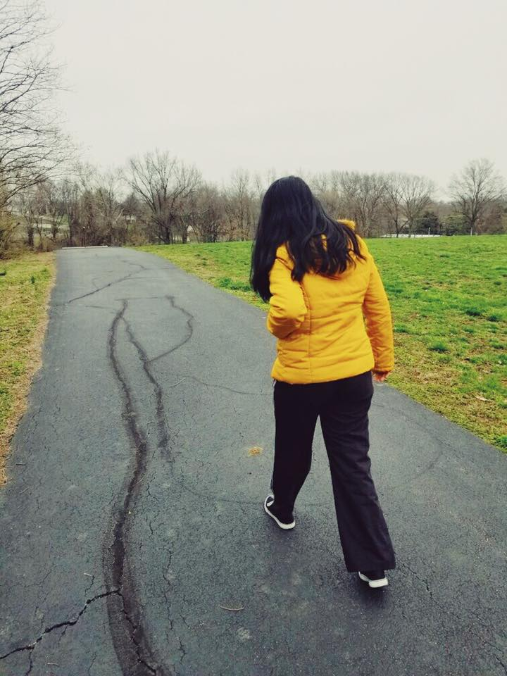
BSP: Behavior Support Plan
Proactive strategies to address problem behaviors and skill acquisition behaviors.
Appropriate behaviors to increase and interfering behaviors to decrease
Prevention strategies
Replacement skills
Consequence strategies
Long-term strategies
Only for clients receiving Behavior Analyst services
All staff must receive BSP training on each client they work with who has a BSP. Staff must always follow the BSP!
Notes:
BSPs or Behavior Support Plans are written by BCBAs and provide proactive strategies to address problem behaviors and improve skill acquisition behaviors.
They address appropriate behaviors to increase and interfering behaviors to decrease
They provide prevention strategies, replacement skills, consequence strategies and long-term strategies to address appropriate and interfering behaviors
The only clients who have BSPs receive Behavior Analyst Services
All staff must receive BSP training each of their clients who have a BSP. Some BCBAs will choose to provide extra training at the house or office when staff begin working in the field.
Staff must follow a client’s BSP at all times!
If you ever have any questions about your client’s BSP, ask your supervisor or your client’s BA.

Slide 9
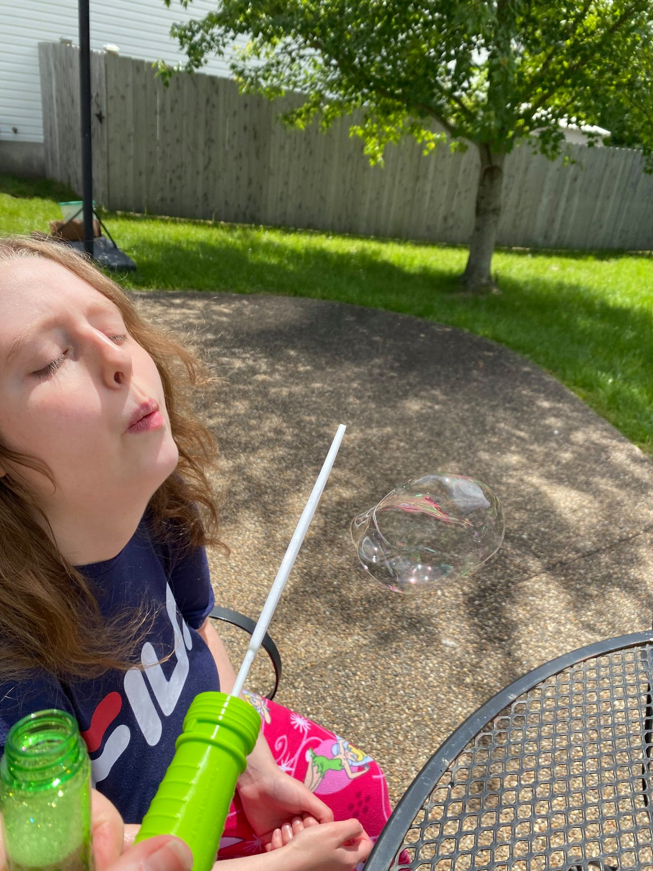
ISP: Individual Support Plan
Overall summary of the client
Narrative of the client’s life.
All ISL clients have an ISP.
ISPs written by a Service Coordinator.
All staff must receive ISP training on each client they work with who has an ISP. Staff must follow the ISP at all times!
Notes:
Every ISL client has an ISP.
They are an overall summary of the client's life and include all of the important information about your client. Not only do you read them during training week but they are also in all of the houses for your reference once you start working shifts and working with your clients.
ISPs are written by your client's service coordinator with assistance from staff and directors

Slide 10
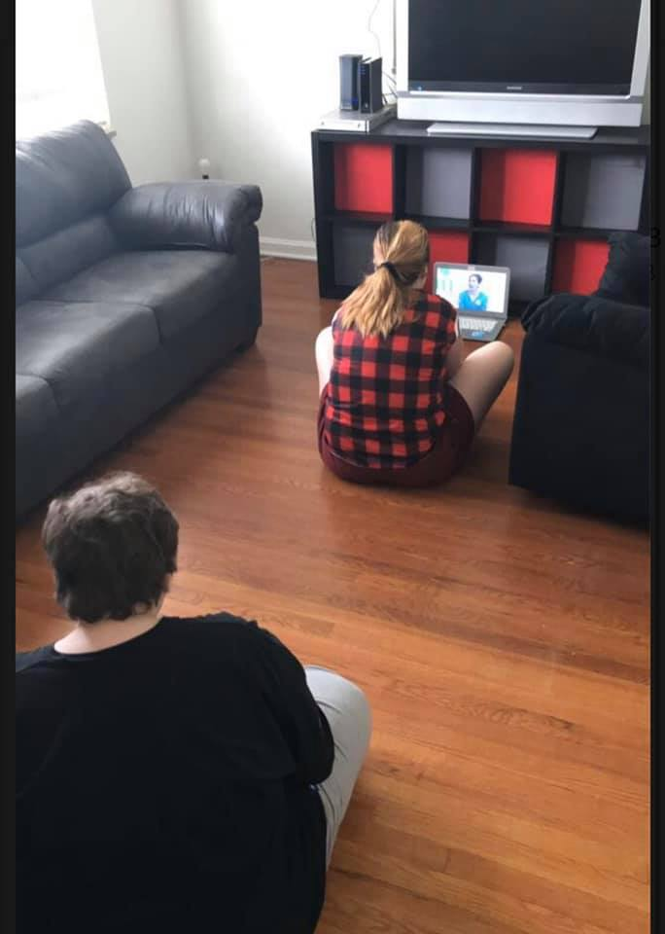

What's in a Client's ISP?
The client’s demographic information
Who/What is important to the client
Who contributed to the plan
Safety procedures/outing procedures
What do staff need to know to appropriately support the client
What supports are needed for health and safety, if any
Requirements of family of minor child or guardian
How the person communicates
Issues to be resolved/concerns
Action plans toward meeting outcomes
Legal issues
  Locks of doors, cabinets, refrigerators
  Restrictions put in place must be approved by the Due Process Committee
Notes:
The things that are included in your clients' ISPs are:
Your client's demographic information
Who and what are important to your client
Who contributed to the plan
Any safety or outing procedures you may need to know
What do you as staff need to know to support your client?
What support does your client need for health and safety
If your client has a guardian, what does that look like? Full guardianship, medical guardianship, financial guardianship
How does your client communicate
Any sort of issues or concerns that need to be resolved
The action plan toward meeting outcomes – what are their goals that you should be working on?
Any legal issues that your client may have – doors being locked, any sort of rights restrictions, etc

Slide 11
Due Process Committee
All restrictions have to go through DPC
  Calorie Counts, Plexiglass, Locked Doors
Held every 3 months at BIS
Committee includes DMH reps, community members, and BIS staff
Either ISL Managers or BCBAs present
If it passes it is implemented in the house
If it does not pass, it is not implemented
Reviewed annually usually around ISP time

Slide 12
RBT Required Documents
Electronic Daily Progress Notes (on SETWorks)
Behavior Data Sheets (paper document)
Monthly Supervision Log

Slide 13
ISL Required Documents
MARs (Medication Administration Records)
*E-MAR
BM Logs (on MARS)
Controlled Substance Logs
Mileage Logs
Shift Change Checklist
Cleaning Checklist
Daily Progress Notes and Timesheets (DPNs, completed on SETWorks)
  Intake Logs
Behavior Data Sheets (paper documents)
Money Logs (chaperone and personal funds)
Others as needed

Slide 14
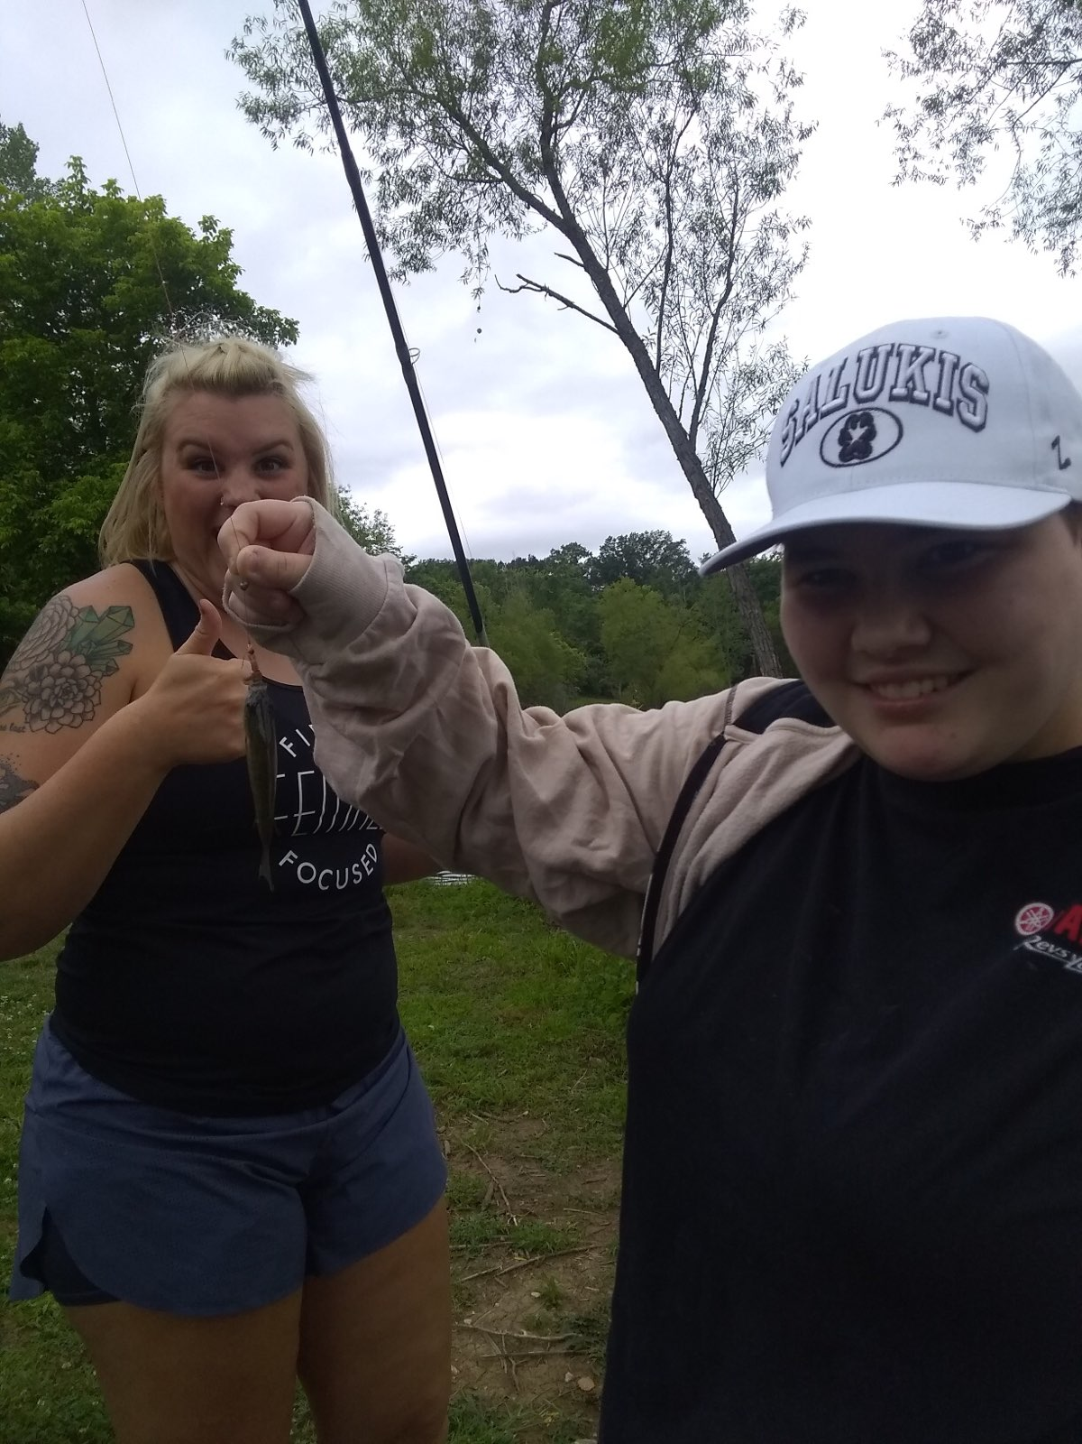
DHSS Required Documents
Daily Progress Notes and Timesheets (DPNs, completed on SetWorks)
Behavior Data Sheets
Mileage Logs
MAR (for Day Hab Managers)

Slide 15
Daily Progress Notes
Must be accurate
They are:
Your “timesheets”
A legal representation of services provided
Historical content which shows previous services offered
A requirement for every shift
Only have 72 hours after shift to complete document!!
Ideally needs to be completed before leaving shift (tablets, laptops)
NO BLANKS!

Slide 16
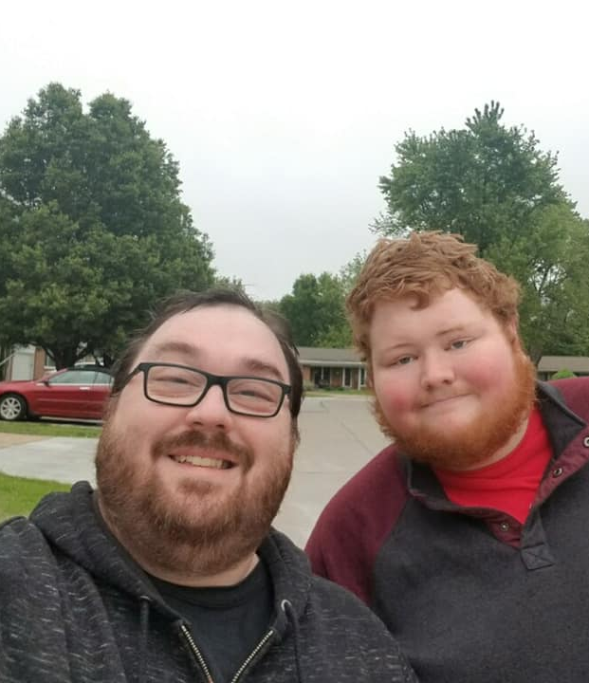
What's on a DPN?
Not all DPNs are made equally. Each is designed based on the client’s BSP and ISP. Here is some information that may be included on a DPN:
Progress made towards outcomes
Any doctor’s appointments attended
Any medications that have been given
Any new medical information specific to the client (i.e. illness, new medication order, etc.)
Any visitors to the home
Any pertinent phone conversations
Any unusual incidents/Emergency situations
Behavior incidents
The emergence of any new behavior concerns
Community outings
Any new skills that have been mastered
Notes:
Overview what should be included
Use examples, call on people, have them give examples
-

Slide 17

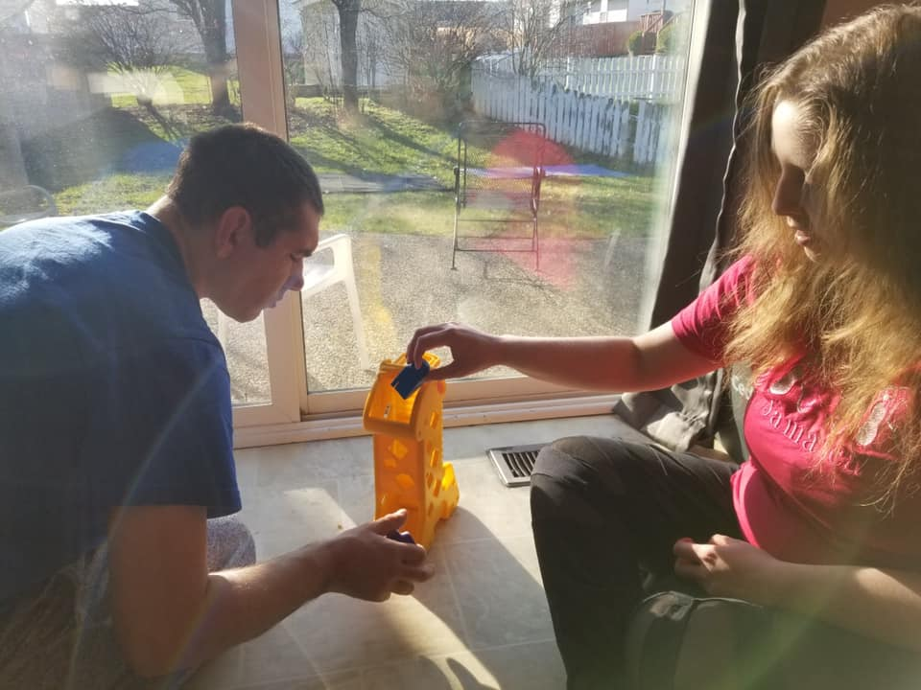
Time Outs & Restraints
Cannot be used as punishment
Must be the choice of the client
Time Out = NO
Break = YES
Mandt
Last Resort
Keep you and your clients safe
Notes:
No support plan will utilize a “time out” method to implement a plan. During stimulation or trigger phase (Mandt) our staff may implement a removal from that stimulus or trigger or may have the client request to take a break from the current task until they have calmed themselves or they may be allowed to work in personal time into their daily activities as part of a planned day but a traditional time out method should never be used outside of the boundaries and expectations set forth in a support plan.
The restraint of a client should always be a last resort in order to keep your client or those around them safe. Only Mandt approved techniques should be used as approved restraint or blocking techniques.

Slide 18
In the event that a behavior crisis or injury to staff occurs during a shift, the staff is/are not to leave the home prior to the following procedure:
  The team’s Manager and/or BA has been contacted
  The Incident Report has been filled out on SetWorks
  The situation has de-escalated
  A supervisor gives permission to leave
If it’s near the end of your shift:
  Wait until the staff relieving you has arrived
  Wait for permission from a supervisor or parent (Natural Home) to leave
  Leaving beforehand = job abandonment and neglect
Behavioral Crisis Procedure
Notes:
-Change RQM
-Job abandonment/ neglect and required to turn over to DMH for investigation
- not leaving shift in general
-staffing ratios ; expanding on why so important = include communication with supervisor

Slide 19
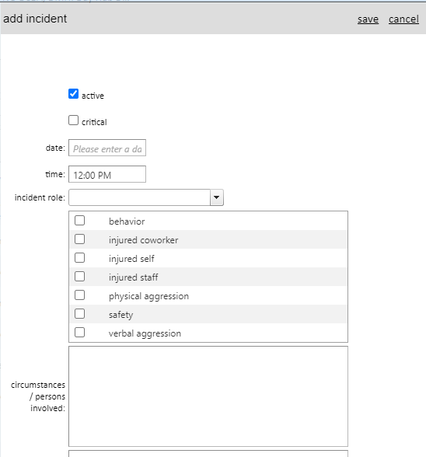
CERFs/EMTs
If you or a client is injured, or if a client experiences a behavioral crisis, fill out an Incident Report on SetWorks (or paper for Day Program)
Always report a Community Event to your DBAS (Natural Home) or Manager (ISL).
What is considered a “Community Event” for one client may be a daily occurrence for another.
Paperwork and reporting must be completed within 24 hours of the incident.

Slide 20
Scenario
You are at the park with your client. Your client gets down on the ground and begins to hit their head on the sidewalk, resulting in a cut on their forehead. You attempt to redirect them. They begin to walk down the sidewalk with you. As you are walking, your client begins bite their arm.
Notes:
Add back

Slide 21

Workman’s Comp
If you are hurt in any way, you MUST contact your supervisor immediately after order has been restored with the client as well as fill out either Worker’s Comp or Non-Injury Waiver.
If you would like treatment through Workman’s Comp, you must wait for another staff or supervisor to relieve you on your shift.
Once you have been relieved, seek treatment at the Urgent Care or ER listed in the packet.
If you choose not to seek treatment and fill out the Non-Injury Waiver, contact your supervisor
In the event of a true medical emergency, call 911 first, then your site supervisor

Slide 22
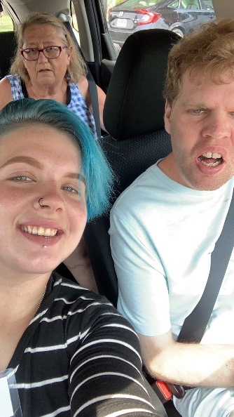
Mileage Repayment
ISL Mileage
Paid out at .63 cents per mile
Each client's mileage payout is maxed by their budget
  Budget varies by client
  Mileage repaid cannot exceed the budget
  If staff miles exceed budget then pay is reduced until .25cents per mile. Pay will not drop below .25cents per mile
Mileage is completed in SetWorks
Mileage must be submitted ASAP (input the day you travel to ensure it will be reimbursed)
Day Program Mileage
Paid out at .63 cents per mile
Mileage is due at the end of each month
Submitted mileage must be on time or payout will not occur
If staff miles exceed budget then pay is reduced until .25cents per mile. Pay will not drop below .25cents per mile
Mileage should be tracked on paper logs and turned in to DH Director at end of each month
Being able to drive a client during each shift is a requirement for all DSPs and DHSS.
Staff can be reimbursed for distance driven during a shift.
Notes:
If staff miles exceed budget then pay is reduced until .25cents per mile. Pay will not drop below .25cents per mile
If staff miles exceed budget then pay is reduced until .25cents per mile. Pay will not drop below .25cents per mile

Slide 23
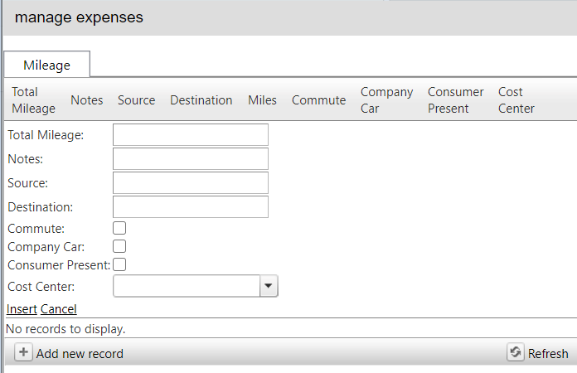

Mileage Logs
Mileage logs are completed through SetWorks
ISL mileage must be reported every shift.
Use smallest distance between locations so you can save on gas.
Notes:
-include how to resolve issue; who to reach to site supervisor
-

Slide 24
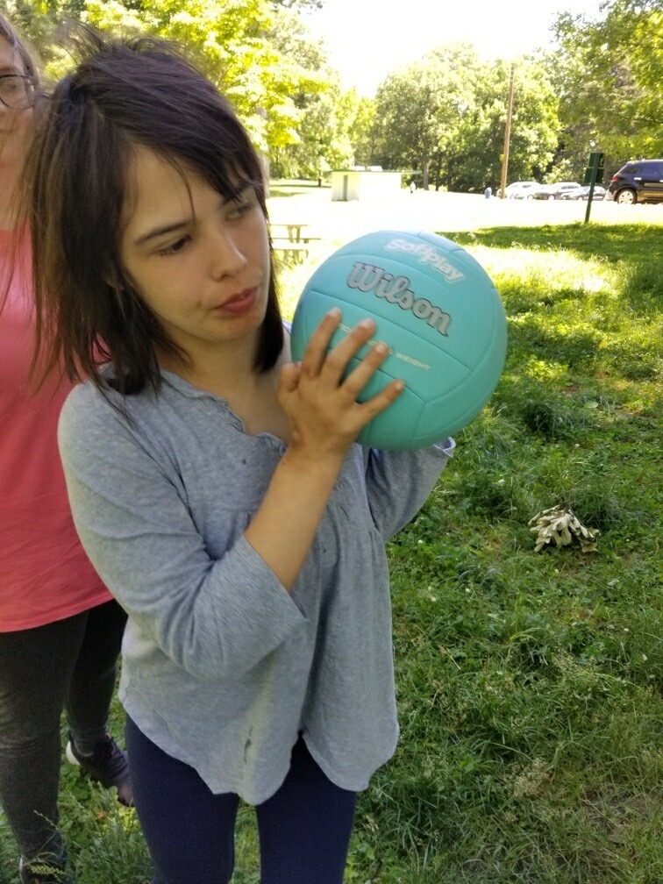
Client funds
ISL clients are funded by the state of Missouri, unless otherwise noted.
Natural Home clients’ families pay for services via insurance, private pay or TRICARE.
Staff are responsible for tracking all of the client’s money which is used during any shift they work.
Pocket Money/Personal Funds (family or client)
Chaperone funds (funded by BIS)
All spending must be accounted for. Staff must keep and record ALL receipts for each funding source
Notes:
-receipt examples include “how to”
-money ledgers, counts,

Slide 25
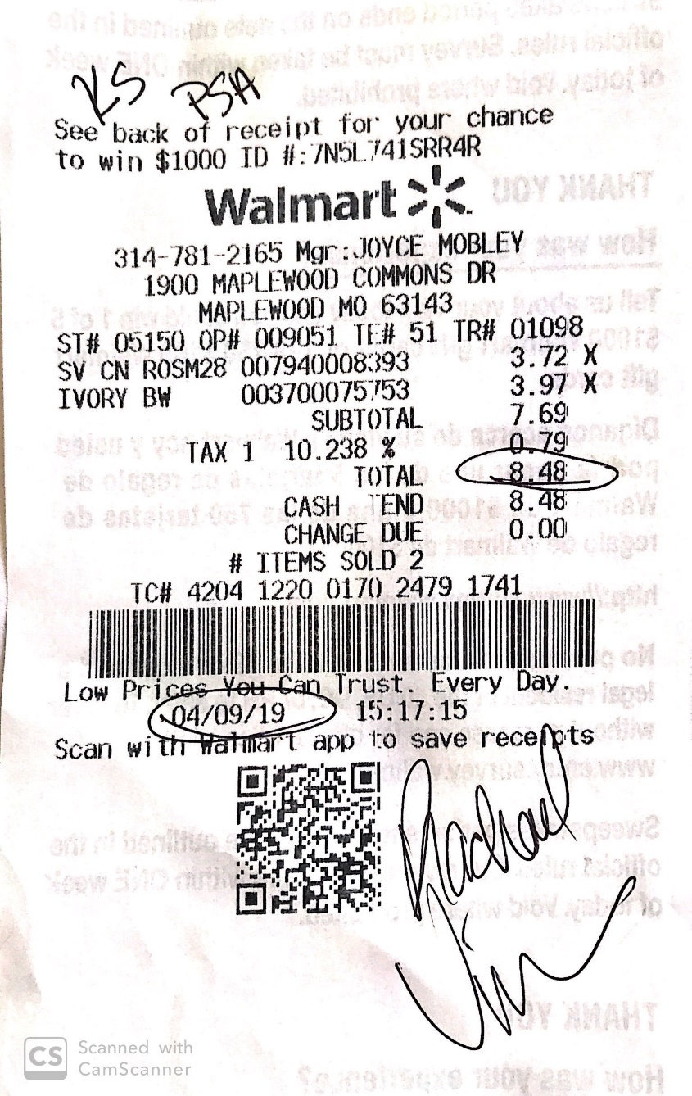
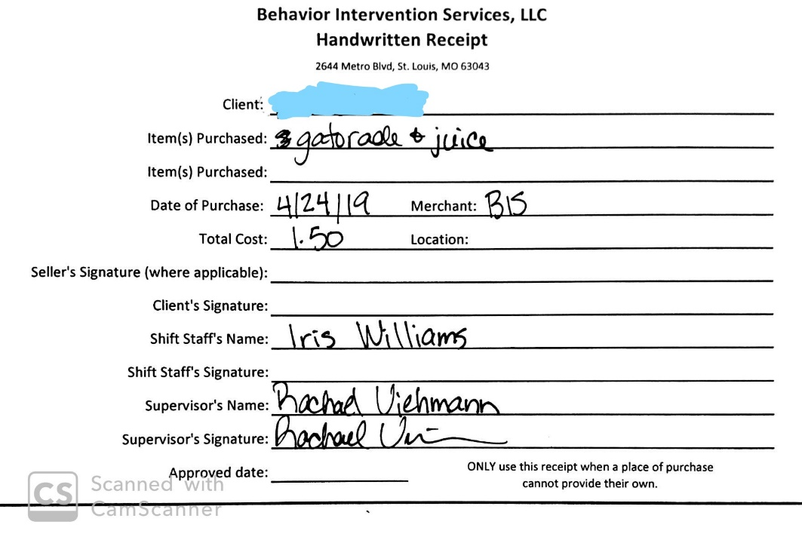
Receipts

Slide 26
Money Counts and Spending Ledgers
Money counts should be completed at start of each shift.
If the amount you count does not match the ledger, it needs to be reported to your supervisor IMMEDIATELY
Spending ledgers are completed on paper and on SetWorks each time a purchase happens

Slide 27
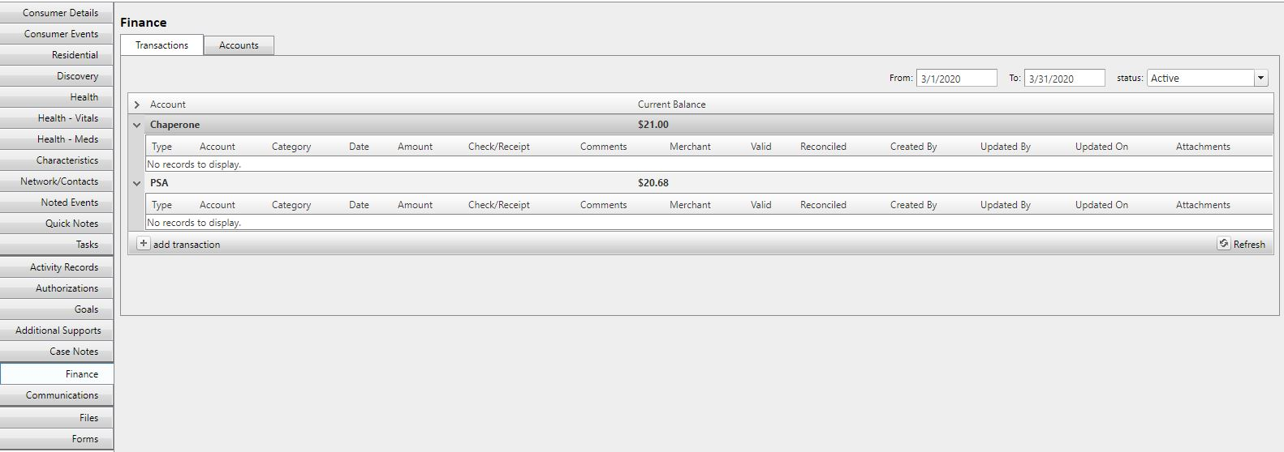
SetWorks Ledgers
Are completed with paper ledgers
Should be completed on shift that purchase happens
Notes:
Setworks ledgers are completed along with paper ledgers whenever you make a purchase with a client.
This includes purchases made with chaperone funds, PSA, their EBT card, or if it is a grocery/household purchase
Same as paper ledgers, SetWorks financial ledgers need to be updated on the shift that a purchase happens
Go to SetWorks and show them a ledger and how to complete

Slide 28
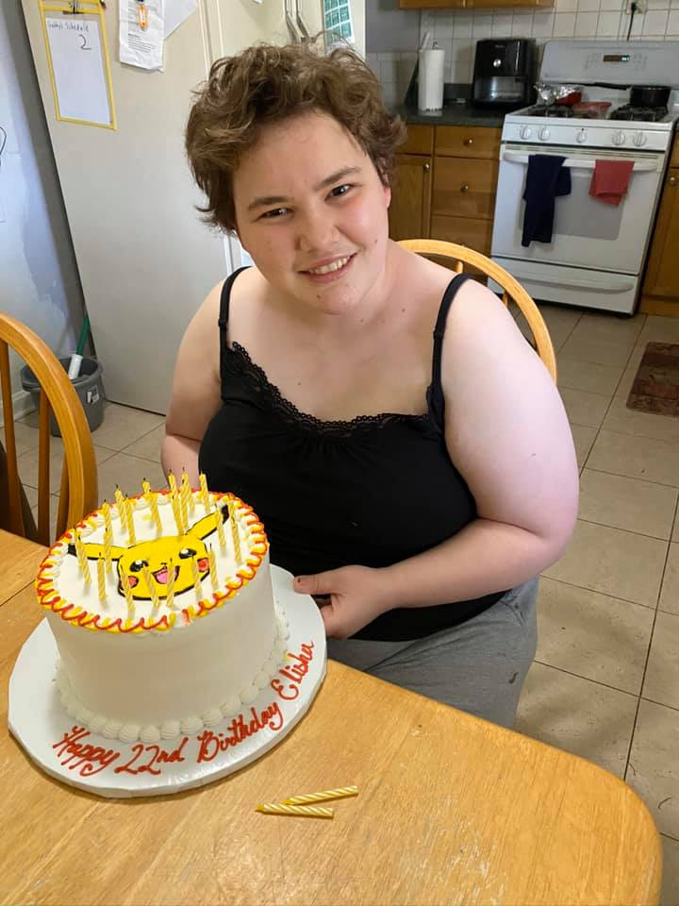
Buying a Client Gifts
  Any additional purchase made outside of the provided client funding must be approved by the CBAS or ISL Manager for each client
    This is to prevent perceived gift/purchase entitlement of the client
        Sets-up expectations that all staff should buy them something
    Staff cannot bribe clients
      “If you do/stop that…then I will buy you…”
      “Be a good girl today and I will take you to McDonald’s”
Notes:
Behavioral issues; temporary fix undermines long term goals
Adopt family times and birthdays

Slide 29
Being a Mandated Reporter
Neglect
Applies to everyone working with vulnerable persons.
Report any suspected or observed cases of Abuse or Neglect.
Attempt to stop the abuse/neglect, then…
Report it to your supervisor ASAP.
Child Abuse Hotline:1-800-392-3738
Adult Abuse and Neglect Hotline1-800-392-0210
Verbal Abuse
Physical Abuse
Sexual Abuse
Misuse of Consumer Funds/Property

Slide 30
ISL Communication
Communication is VERY important. There is a right way to do it.
Please reference the BIS Call List for anything you need on shift/at the house
Non-emergency phone calls to your supervisor are to be placed only between the hours of 8am and 6pm Monday-Friday
On-Call Director: 314-624-8404

Slide 31
Emergency Communication
Call 911 in the event of a true medical emergency, then your supervisor
An Incident Report is filled out (review EMT reporting procedure)
You do not have a vehicle, or you are having car troubles
Any medication concerns or abnormal medical changes
Medication Errors are discovered
You have questions or concerns about your shift
Items are not completed or not completed correctly by the shift you are relieving
Call your Supervisor when:
You witness or suspect abuse/neglect
Non-medical emergencies
A client is ill
A client is missing
A client falls or is injured
Staff injury (workers comp)
Situations when staff/client are feeling threatened
Notes:
Have them review policy –ask them review questions, give examples of who to call. Incident/Event Report Forms Procedure:
Any time an Event Report Form is filled out by staff or ISL Manager the ISL Director must be notified.
When an incident report must be filled out, the ISL Manager needs to notify the ISL Director, Community RN, Agency Assistant Director, and Executive Director by email and guardian of the incident by phone (or as indicated in consumer’s ISP). Here is a list of incidents that require an Event Report Form to be filled out.
Ingestion of a non-edible food item
Destruction of staff property
Elopement
ER Trip
Fall
Fire
Consumer Found on Floor
Misuse of Funds
Injury to Consumer- Unknown or known Origin
Med Error
Near Fall
Physical Abuse
Neglect
MANDT Restraint
Sexual Abuse
Theft
Threat/Harm
Vehicular Accident
Extensive Property Damage- any item that must be replaced
Staff may fill out an Event Report Form, but the ISL Manager must make sure that it has been completed correctly.
The ISL Manager must contact the guardian of the individual within 24 hours and document this contact on the Event Report Form as indicated. Guardians should be notified within 2 hours of the incident.
If the any of the incidents have occurred below the ISL Director and guardian must be notified immediately by phone call.
Emergency Room Trip
Vehicular Accident
Sexual abuse
Fire
Abuse and neglect
A copy of the Event Report form must be turned into the ISL Director at the BIS office within 24 hours of the incident/discovery time.
If it is during a Friday evening or Saturday, the report must be turned in at the office by 9:00am on Monday.
If it is a holiday or the BIS office is closed, the report must be turned in at the office by 9:00am on the next business day.
Any time an Event Report Form is completed by staff or ISL Assistant Manager (see Incident/ Event Report Forms Procedure) the ISL Manager must be notified.
Once ISL Manager receives notification that an Event Report Form is being completed, the ISL Manager must send out notification summary to the ISL Director, Community RN Director, Agency Assistant Director, and Executive Director as soon as possible, but no longer than 2 hours after receiving notification that an Event Report Form is being completed unless one of the incidents occurred from number 5a-e.
Notification from a ISL Manager should always be sent out in email form unless an incident occurred from number 5a-e then a phone call must be placed to the ISL Director and guardian immediately.
In the event that a Home Supervisor completes an Event Report Form themselves they are responsible for contacting the ISL Manager, ISL Director, Community RN Director, Agency Assistant Director, and Executive Director as soon as possible, but no longer than 2 hours after receiving notification that an Event Report Form is being completed.
Notification should always be sent out in email form unless an incident occurred from number 5a-e then a phone call must be placed immediately to the ISL Director and guardian immediately.
If a Home Supervisor or ISL Manager doing notification through email or phone call and does not receive a response:
Please refer to BIS Communication Policy.

Slide 32
EVENT REPORT Review
Fill out An Incident Report on Setworks for any of the following categories and contact the ISL Manager or ISL Director:
Reportable Category #1: All events where there is a report, allegation, or suspicion that an individual has been subjected to Misuse of Consumer Funds/Property, Neglect, Physical Abuse, Sexual Abuse, or Verbal Abuse.
Reportable Category #2: All…
    Emergency Room Visits
    Non-scheduled Hospitalizations
    Deaths of Individuals Served by DMH
    Medication Errors that Reach an Individual (NOT documentation errors)
    Incidents of Falls
    Uses of Emergency Procedures
      Chemical Restraint
      Manual Restraint
      Mechanical Restraint
      Time Out Procedures
Reportable Category #3: All events where there is Law Enforcement or emergency personnel involvement when the DMH consumer is either the victim or alleged perpetrator, or Law Enforcement is support in the event.
Reportable Category #4: All events that result in disruption of DMH service due to fire, theft, or natural disaster resulting in extensive property damage or loss.
Reportable Category #5: All events where there is sexual conduct involving an individual, and it is alleged, suspected or reported that one of the parties is not a consenting participant.
Reportable Category #7: All events where the consumer ingests a non-food item (any item that is not food, water, medication, or other commonly ingestible items).
Reportable Category #8: All events that result in a need for an individual to receive life-saving intervention or medical/psychiatric emergency intervention.
If the event is considered a DMH Critical Incident, an Addendum must accompany the DMH community Event Report Form. Critical Incidents are defined as follows:
    Death of a consumer suspected to be other than natural causes.
    Injury to a consumer.
    Serious incident of abuse/neglect, including abuse/neglect involving death, serious injury, and sexual abuse.
    Suicide attempt resulting in an injury requiring medical intervention
    Elopement with law enforcement contacted or involved
    Criminal activity reported to law enforcement involving a consumer as a perpetrator or victim when the activity occurs at a facility. If not at a facility, then the criminal activity is serious (felony, etc.)
    Fire, theft, or natural disaster resulting in extensive property damage, loss or disruption of service in department state operated facilities.
    DMH Event Report Form should still be filled out for the following:
  Behavior of an unusual nature for the consumer
  Consumer escalations that result in injury of staff or consumer
  Consumer escalations in the community that result in injury of staff, consumer, or community member.
  Property Damage that results in an item needing replacement (including staff, consumer, and community property)
  Elopement
  Vehicle collisions or accidents where a consumer is present in an involved vehicle
  Falls or drops by the consumer
  Any other situations that staff deems necessary to report

Slide 33
ISL After-Hours Communication
The On-Call Manager or Director will:
  Respond to all calls and texts within 20 minutes according to BIS Policy
  Determine if the information received in the call/text is an emergency.
  If the call is an emergency, they will provide phone emergency support as necessary giving guidance to the person calling.
  If the call is a non-urgent matter, they will assist employee/guardian with their issue and remind them how to contact they Manager/Director during normal business hours.
  On-Call Manager/Director will inform the appropriate Manager/Director of any non-urgent issues by 9am and the Manager/Director will follow up by on those issues by 12pm.

Slide 34
Natural Home Contact Hours
Monday – Friday (9am – 5pm)
The Director of Behavior Analytic Services can be reached at the office (314) 395-9375.
Monday – Friday (5pm-9am), Saturdays and Sundays
Call the after-hours phone number for urgent matters. You’ll be able to reach the Clinic Coordinator

Slide 35
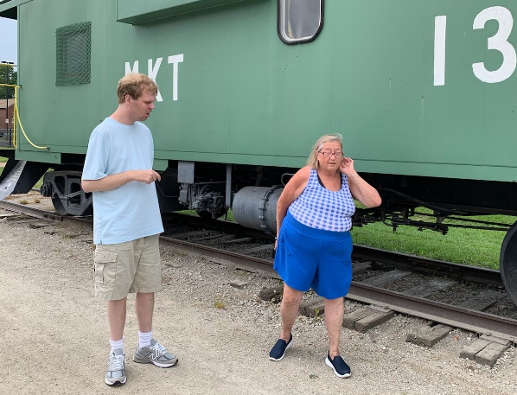
DSP
RBT
DHSS
BCBA
ISL Manager
DH Manager
ISL Assistant Director
Director of Behavior Analytic Services
DH Director
ISL Director​
Chains of Command
Notes:
-update and include DHSS

Slide 36
What's Next?
Questions?/Comments?
Any other required trainings listed on your W2W calendar
Stop by to see
ISL Scheduler Lauren Phillips
And
HR Director Jamie Klamert
And
Staff Trainer Sheena Cole
before leaving to check your employment file for any missing or needed items.
Notes:
-update this

